Slide 1
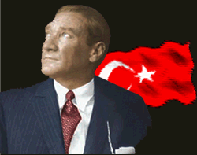

TURKEY

Slide 2
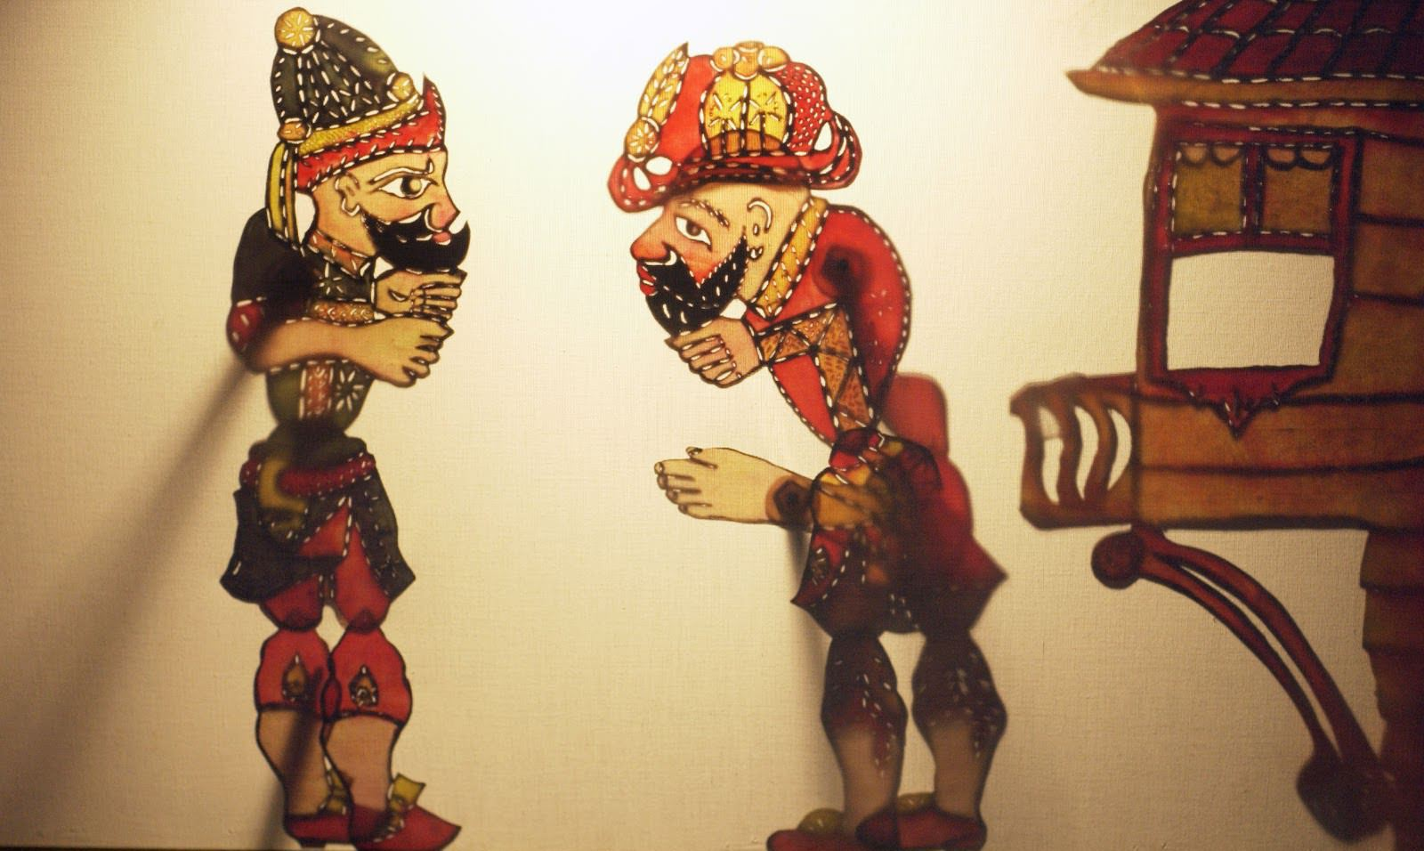
KARAGÖZ AND HACİVAT ##

Slide 3
There are many different types of Turkish theater , Karagöz and Hacivat shadow play is one of them.
Karagöz and Hacivat shadow play is based on imitatings and conversations.
He is called daydreamer who is budged the characters##
his assistant called stooge.

Slide 4
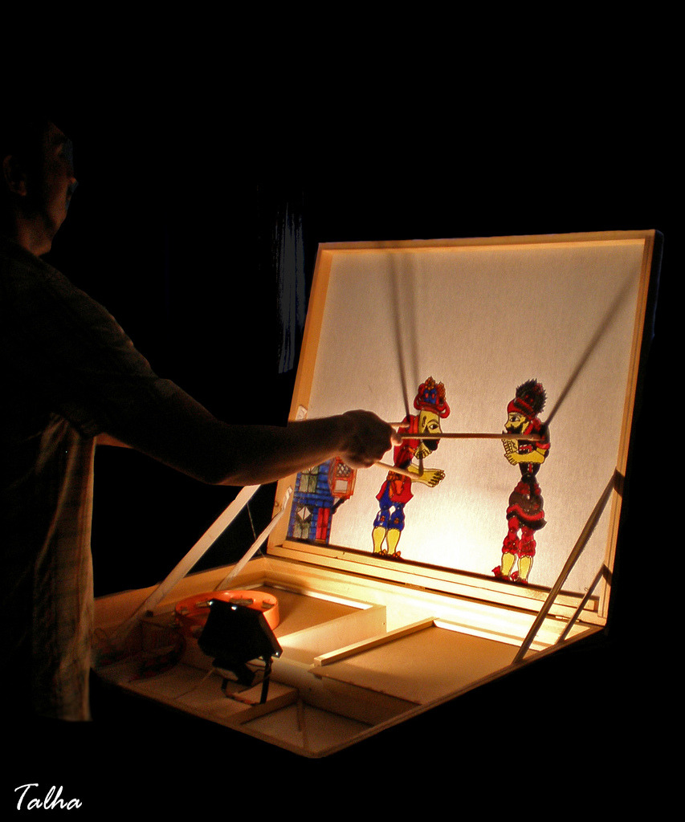

Slide 5
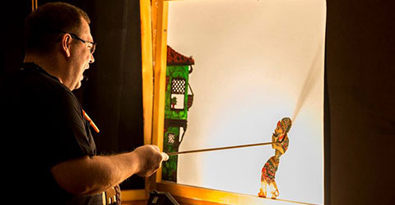
There is a curtain in the play and characters’ shadows are reflected on the curtain, in this manner the curtain becomes the screen . The characters of the play can be made of leather or plastic. ##
Puppets are make active by sticks.
##

Slide 6
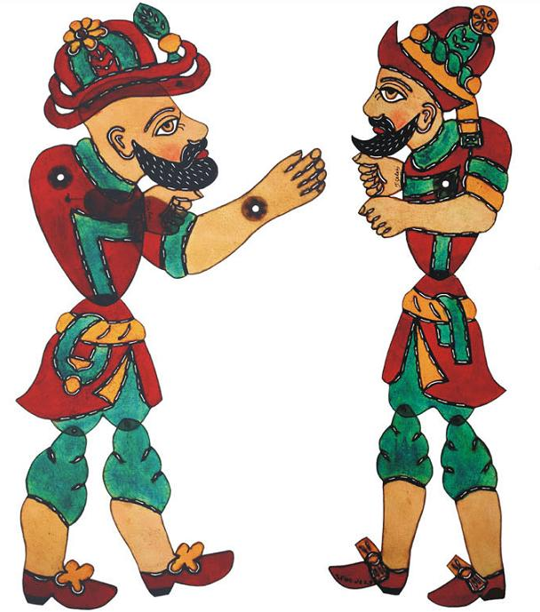
WHO ARE HACİVAT AND KARAGÖZ?
There are different legends about these charecters that they lived, where and when lived
But strongly , they lived in Bursa Turkey during Sultan Orhangazi .
##

Slide 7
One of the Şeyh (Küşteri) loves them very much so he makes theirs puppets and starts to show behind curtain thus tries to make them live.
That makes them immortal .

Slide 8
THE IMPORTANCE OF THE KARAGÖZ AND HACİVAT
Hacivat and Karagöz shadow play is one of the most important part of our culture .Because this play have taken the places of TV and modern theatre for years and years. ##
This play are not only informative for youngs, children and adults but also entertaining. For long years it was indispansable entertaining especially during Ramadan months .

Slide 9
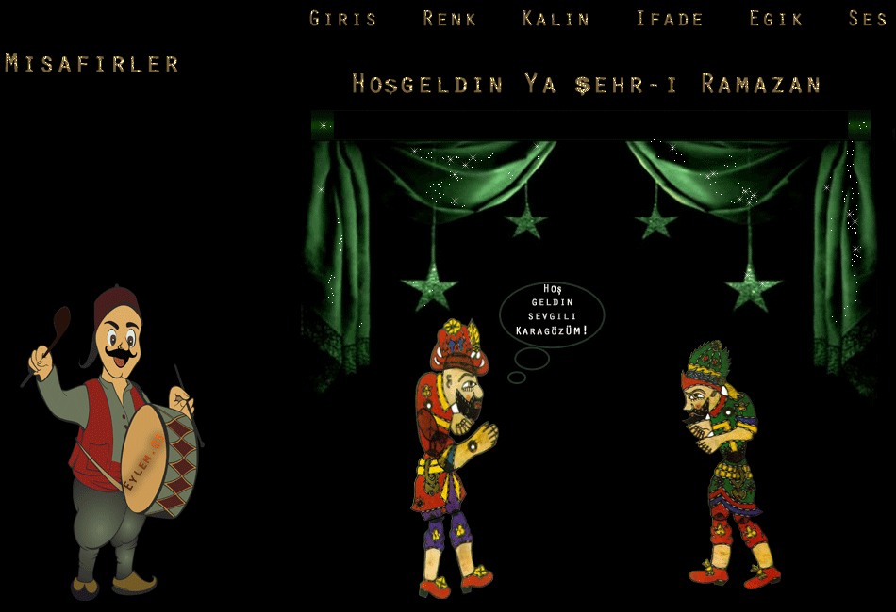

Slide 10
CHARACTERS OF THE PLAY
##
The characters show their features on their own with clothes , behaviors , dances and musics . When they arrive on the scene , audiences recognize them instantly .
Main characters are Karagöz and Hacivat.

Slide 11
KARAGÖZ
He wears hat called ‘ışkırlak’ on his bald head . He hasn’t got regular business and education has not
Hacivat finds temporary jobs for him . He is manful and brave so he is in trouble many times. He is curious and politically incorrect.
Sometimes he tries to cheat by doing tricks. He discusses his friend Hacivat and his wife.

Slide 12
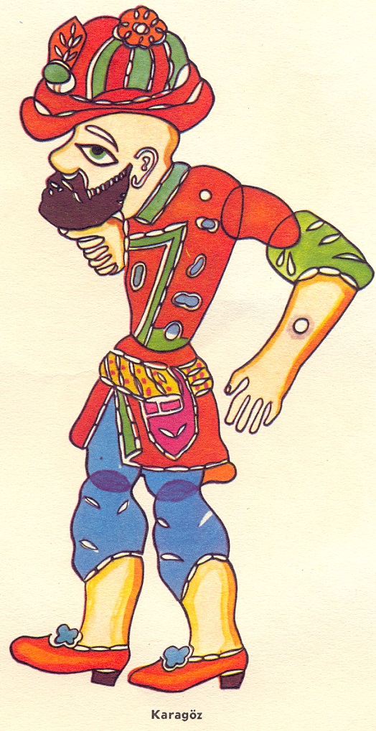
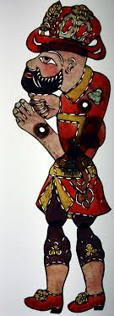

Slide 13

HACİVAT
He has upwardly curved beard.
Hacivat is intelligent cunning and skillful. He has received good education and he has knowledge on many subjects. He talks with Arabic and Persian words so sometimes Karagöz doesn’t understand or misunderstand what he says.
Audiences laugh this misunderstandings.

Slide 14
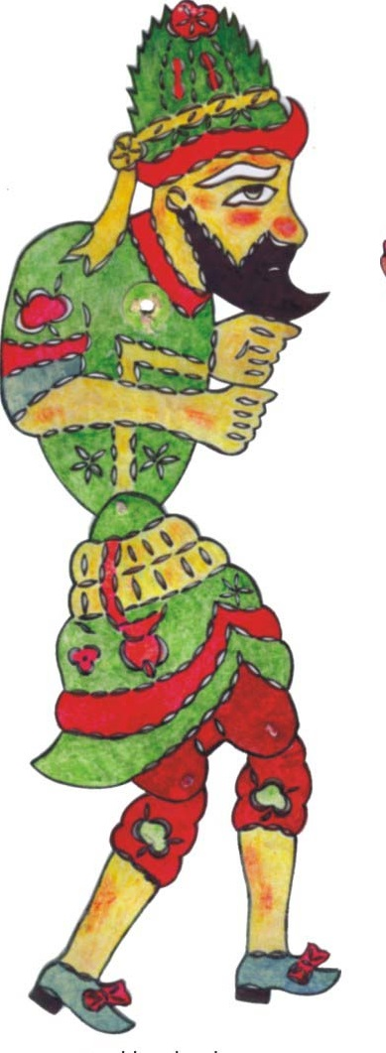
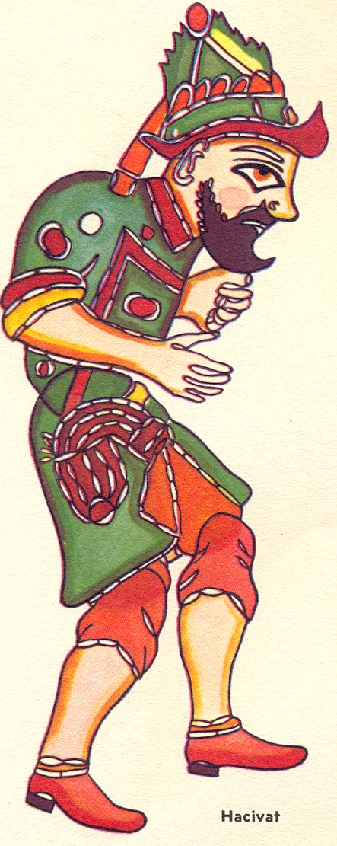

Slide 15
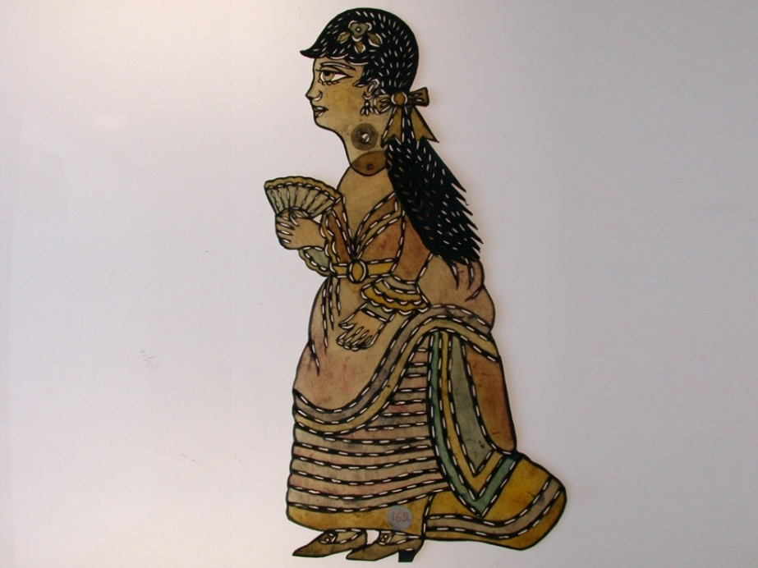
ZENNE
The all women called ‘zenne’ in the play generally.
She is Karagöz’s wife below picture.
Zennes don’t talk too much , sometimes they sing songs. They take a short roles in the play .

Slide 16
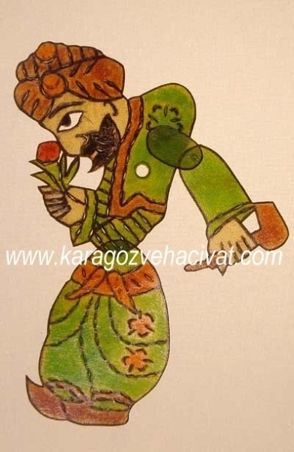
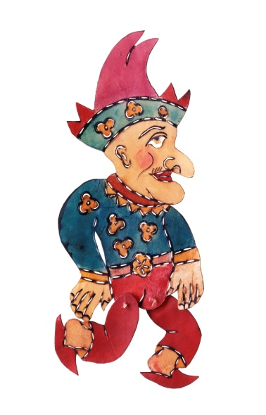
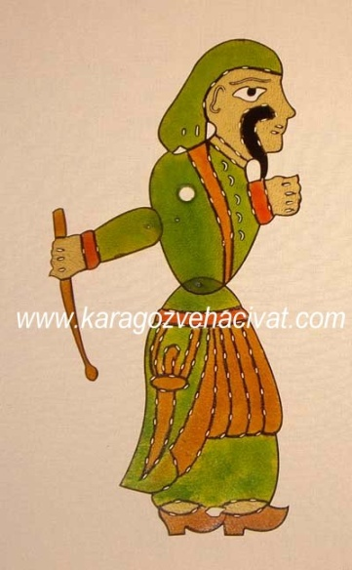
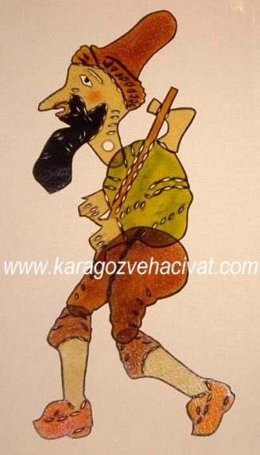

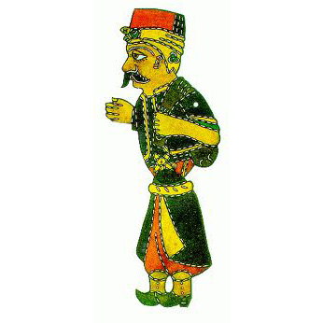
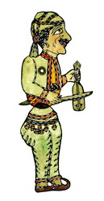
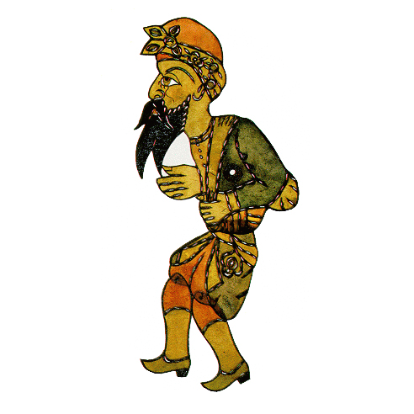
OTHER CHARACTERS

Slide 17
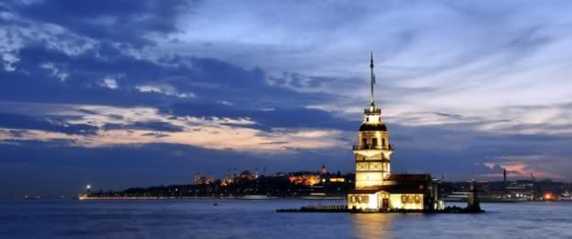
THANKS FOR LISTENING

Slide 18
